Slide 1
Micah 6:8—He has shown you, O mortal, what is good. And what does the Lord require of you? To act justly and to love mercy and to walk humbly with your God.
Matthew 5:14-16—"You are the light of the world. A city set on a hill cannot be hidden; nor does anyone light a lamp and put it under a basket, but on the lampstand, and it gives light to all who are in the house. "Let your light shine before men in such a way that they may see your good works, and glorify your Father who is in heaven.

Slide 2
Writing a poem
The final activity is writing an autobiographical poem using the insights gained from reading the seven chapters of this book. Your poem will be a snapshot of your thoughts and reflections.
Relax with this activity and consider what you write now as a first draft that can be revised later.
.

Slide 3
Template for "I Am Poem"
I am (your name and to whom are you related—perhaps up to three or so relationships)
I am called (a present or future call of service. It can be specific or general that addresses a call to family, church, career, organization, cause, or ideal)
I am afraid (can be either tangible or an idea or emotion of something you fear)

Slide 4
I am mindful of God when (a situation or place that allows you to be aware of God's presence)
I appreciate (some of the people who are part of your care and support)
I am seeking God's guidance (your challenges, concerns, opportunities)
I am the light of Christ because (some belief or way that God's light shines from you)

Slide 5
Break Out Room – Discussion
Think of the people in your life who live in ways that they are lights in the world. What are some attributes of someone whose light shines before others? What role have they played in your life?
If your group has time, each of you may want to share a few lines from your “I Am” poem.

Slide 6
I Am
I am Daborah Alek Majok
I am 15 years
I am in (S-1-A)
I am kind and jolly
I wonder why people fight one another
I hear people slained
I see myself a pilot
I am kind and jolly
I pretend to be holly [jolly]
I feel sad about slained people
I am touched [concerned] about being slained
I feel worried about the being slained
I cry for all the dead
I know people’s lives will improve
I believe their will be a total reformation
I dream being a pilot
I try to study hard for it
I hope i will be a pilot
I am kind and jolly

Slide 7
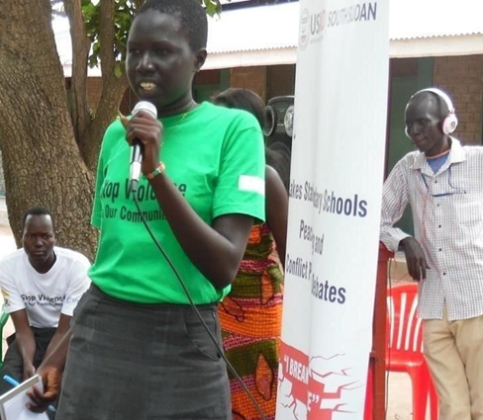
The Call
I speak for all And I call upon all To stop all That causes all Into the drain of conflict and war!
I call upon all To stop all That is morally ill; Sexual immorality, pregnancies, cattle rustling, Revenge, greed for power, greed for wealth, corruption Ethenicism, nepotism and all illisms, Those have brought conflict into play!
I call upon all, to come altogether To table, To become all brothers and sisters, Let us forgive and love each other for peace to prevail.

